Slide 1
Study abroad: Term year Program name program city, country
Faculty-led & custom programs
Presenter name, Title

Slide 2
Explore. Discover.
Insert country.

Slide 3
Join our webinar.
Webinar title:
date:
Time:
Webinar suggested sites:
GOTOMEETING.COM
Anymeeting.com
Note: IF THIS IS AN INFO SESSION ON CAMPUS, DELETE THIS SLIDE.

Slide 4
Get out and see the world

Slide 5
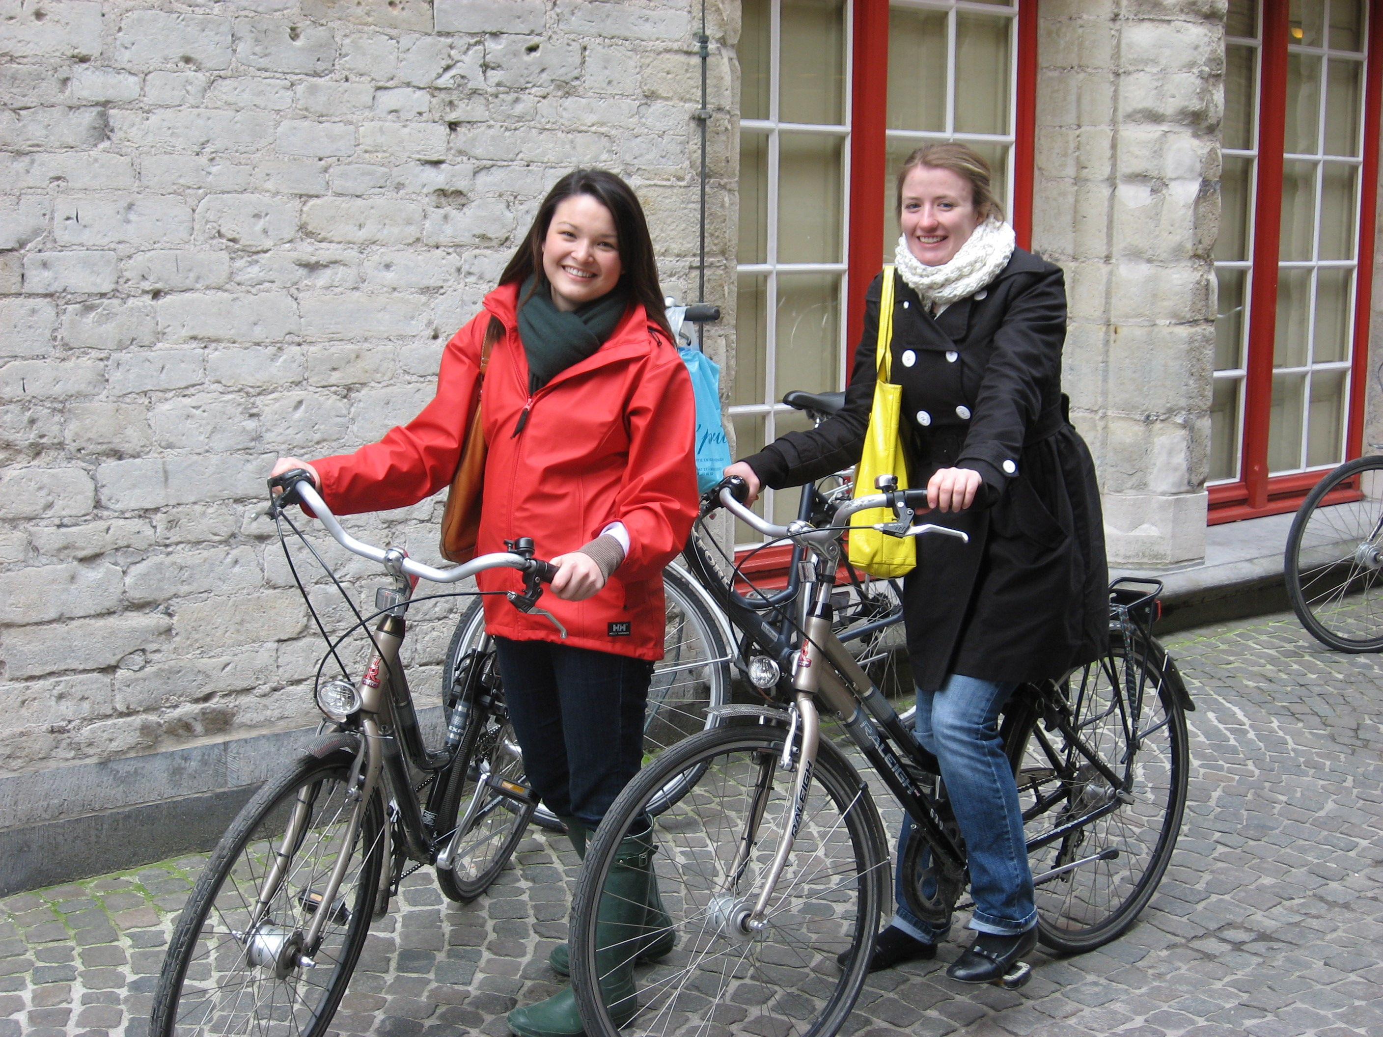
About the Location
Add copy here about Location.

Slide 6
Program Overview
Add copy here about Program.

Slide 7
Program Highlights
Add copy about Program Highlights here.

Slide 8
Program Highlights
Add copy about Program Highlights here.

Slide 9
Program Fee & Eligibility
Add copy about Program Fee & Eligibility here.

Slide 10
Benefits: Why Study Abroad?
Global & Experiential Learning
Students gain understanding, acquire knowledge, and develop skills for living in a globally interdependent and culturally diverse world.
A focus on the end result - global learning delivered through education experiences that allow students to learn in ways different from what the traditional classroom offers.
Study Abroad programs challenge students to continually reflect on their experiences and put that learning into practice.
Students gain global skills beyond what simple exposure to another culture can provide with experiential learning.

Slide 11
Benefits: Why Study Abroad?
Study Abroad Expands Career Possibilities
Studying abroad gives students a broader understanding of career possibilities and the confidence to pursue those paths.
Study Abroad Positively Impacts 21st Century Job Skills
Students significantly improve intrapersonal and interpersonal skills, flexibility & adaptability, confidence & self-awareness, problem solving and teamwork skills, and course or major-related knowledge. Employers value these “soft skills” in new employees as much or more than they value technical skills.
Students Who Study Abroad Earn Higher Salaries
According to the Institute for the International Education of Students (IES) survey of over 3,500 alumni study of program alumni, Americans who studied abroad earned on average $7,000 more in starting salaries than their peers who didn’t go overseas.
Sources: “Gaining an Employment Edge: The Impact of Study Abroad on 21st Century Skills & Career Prospects in the United States, 2013-2016) Crhistine Farrugia, Ph.D. Jodi Sanger, October 2017 – IIE Center for Academic Mobility Research and Impact, IIE Generation Study Abroad.
Alston, Cromartie, Wakefield, and English, 2009; Crawford, Lang, Fink, Dalton, and Fielitz, 2011; Harder, Andenoro, Roberts, Stedman, Newberry, Parker and Rodriguez, 2015

Slide 12
Student Quotes
“My study abroad trip was a great experience that offered more than just gaining a class credit. Going abroad with this program allowed me to compare business in the Netherlands with the U.S. which in return, will help my future career.” CIEE Study Abroad Student ‘17
“My experience with CIEE was life changing. Not only did I personally grow, but I have been successful in my professional career in big part to my experience with CIEE.” CIEE Study Abroad Student ’16
“Set me on a lifelong path of travel. I later became a US diplomat.” CIEE Study Abroad Student, 06

Slide 13
Find out more.
FirstName Lastname
Department
email address
SCHOLARSHIP OPPORTUNITIES:
SCHOLARHIP DETAILS:
CONTACT:

Slide 14
Next steps:
How to sign up:
Contact firstname lastname at email address or stop into the Study Abroad office and ask for more information.
Deadline: December 10, 2017

