Slide 1
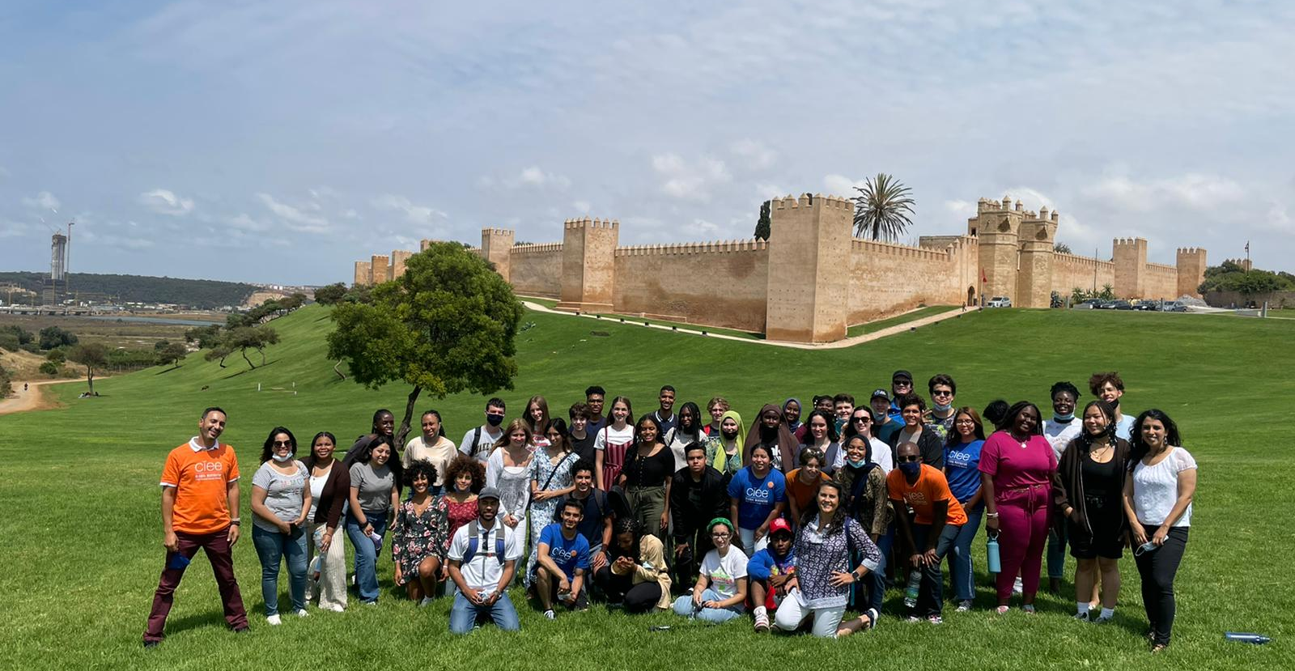
MY SUMMER ABROAD
WITH CIEE
[INSERT A PHOTO HERE THAT BEST CAPTURES YOUR SUMMER WITH CIEE]
Your name / Your School and Grade

Slide 2
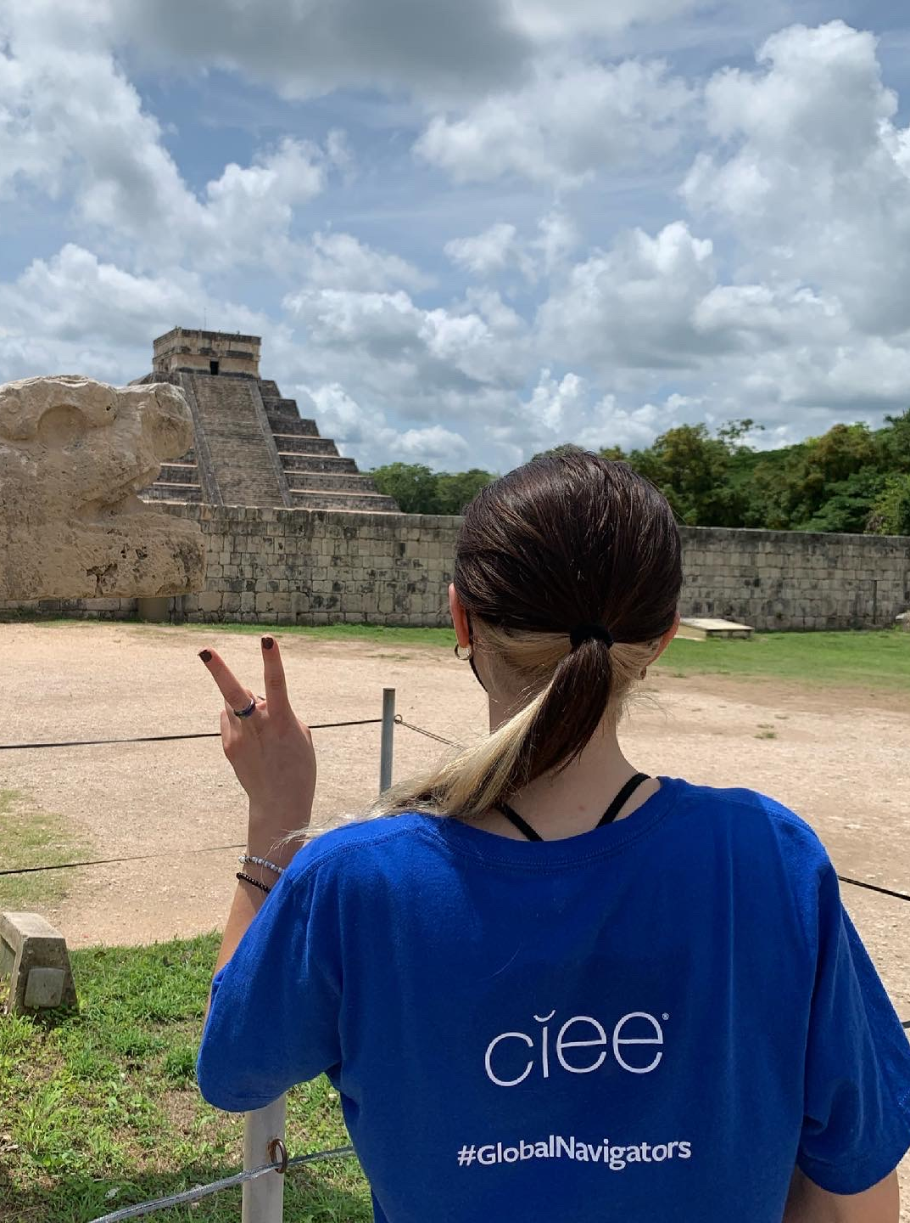
WHERE I WENT
PROGRAM LOCATION:
Living Location:
Cultural Excursions:
Overnight Trips:
CIEE Staff:
[INSERT A PHOTO HERE THAT BEST CAPTURES THE LOCATION YOU WENT TO]

Slide 3
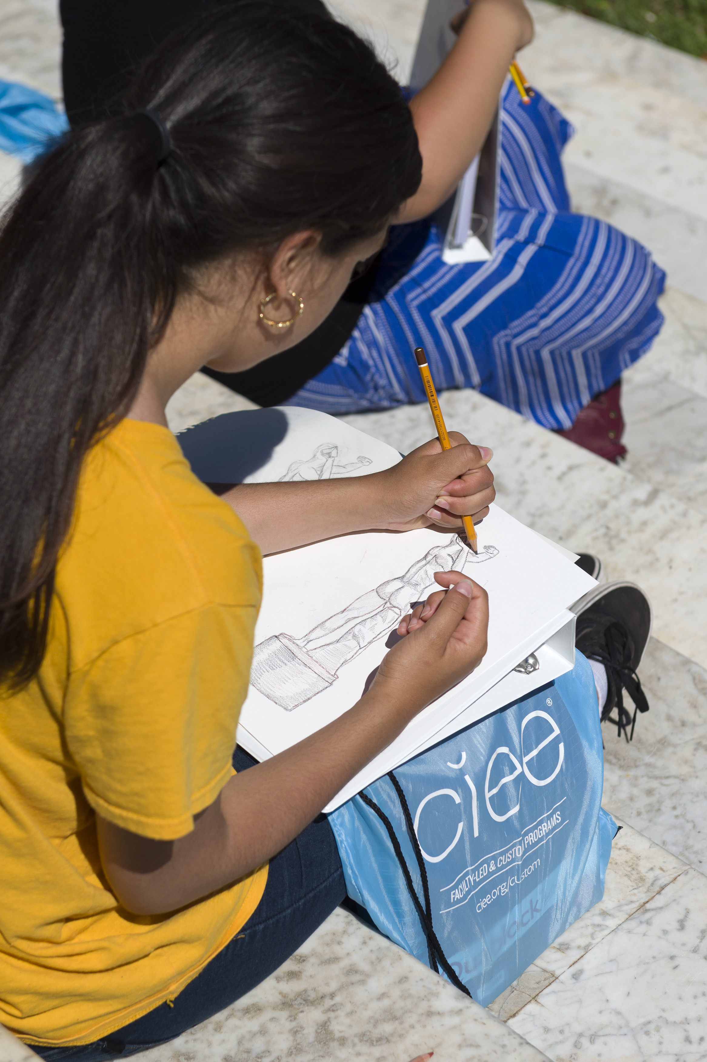
WHAT I ACHIEVED
LANGUAGE IMPROVEMENT
“Can Do” Statements / STAMP pre and post-test
Experience with Host Family:
Experience in Host City and Surrounds:
Experience in Class:
SERVICE PROJECT [IF APPLICABLE]
What I did:
Other Activities:
GLOBAL DISCOVERY CONTENT STUDIES [IF APPLICABLE]
What I Studied:
Other Activities
[INSERT A PHOTO HERE THAT BEST DEMONSTRATES WHAT YOUR EXPERIENCE WAS ABOUT]

Slide 4
MY DAILY SCHEDULE
AT HOMESTAY OR DORM
Wake-up Time:
Typical Breakfast:
Morning Activities:
Typical Lunch:
Afternoon Activity Examples:
Typical Dinner:
Evening Activity Examples:
LANGUAGE CLASS
Time:
Typical Activities:
CULTURAL EXCURSIONS AND WORKSHOPS
Time:
Typical Activities:
SERVICE PROJECT
Time:
Typical Activities:

Slide 5
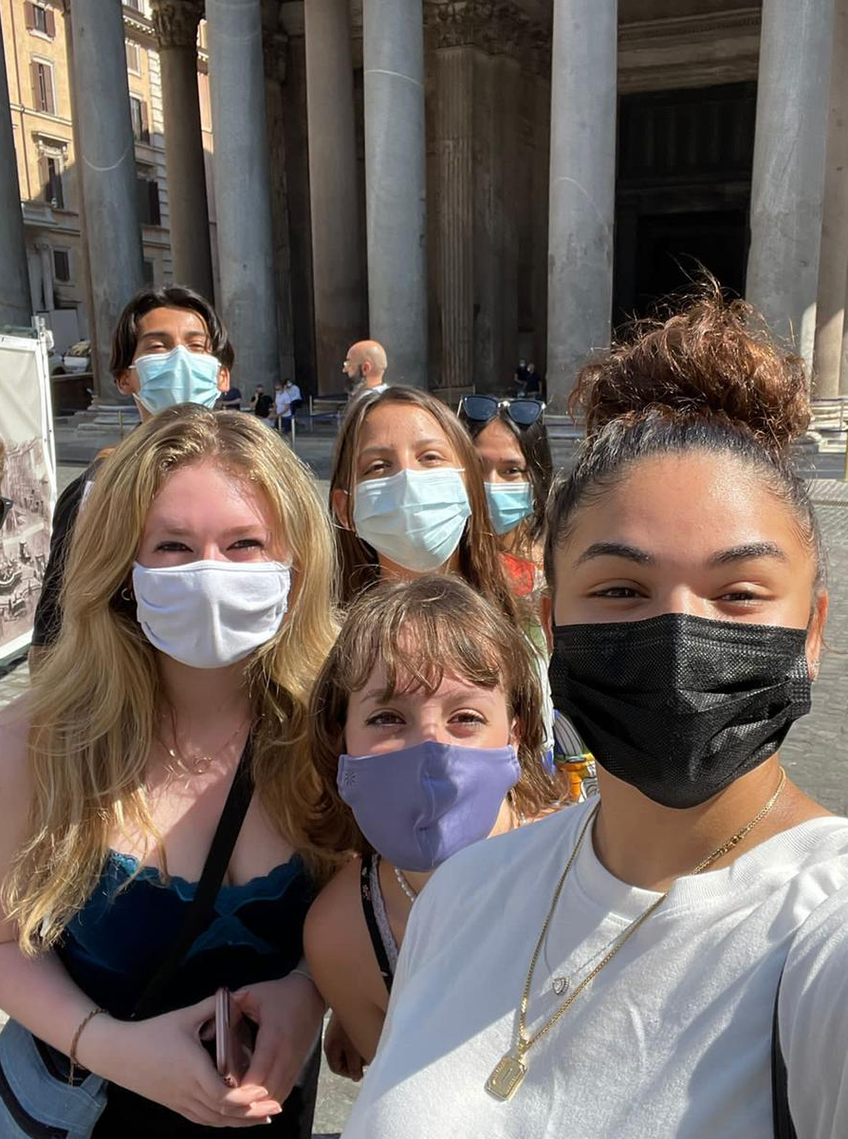
CULTURAL ENCOUNTERS
Favorite Cultural Activity:
Takeaway from Cultural Activity:
[INSERT A PHOTO HERE OF YOUR FAVORITE CULTURAL ACTIVITY OR OUTING DURING YOUR STAY]

Slide 6
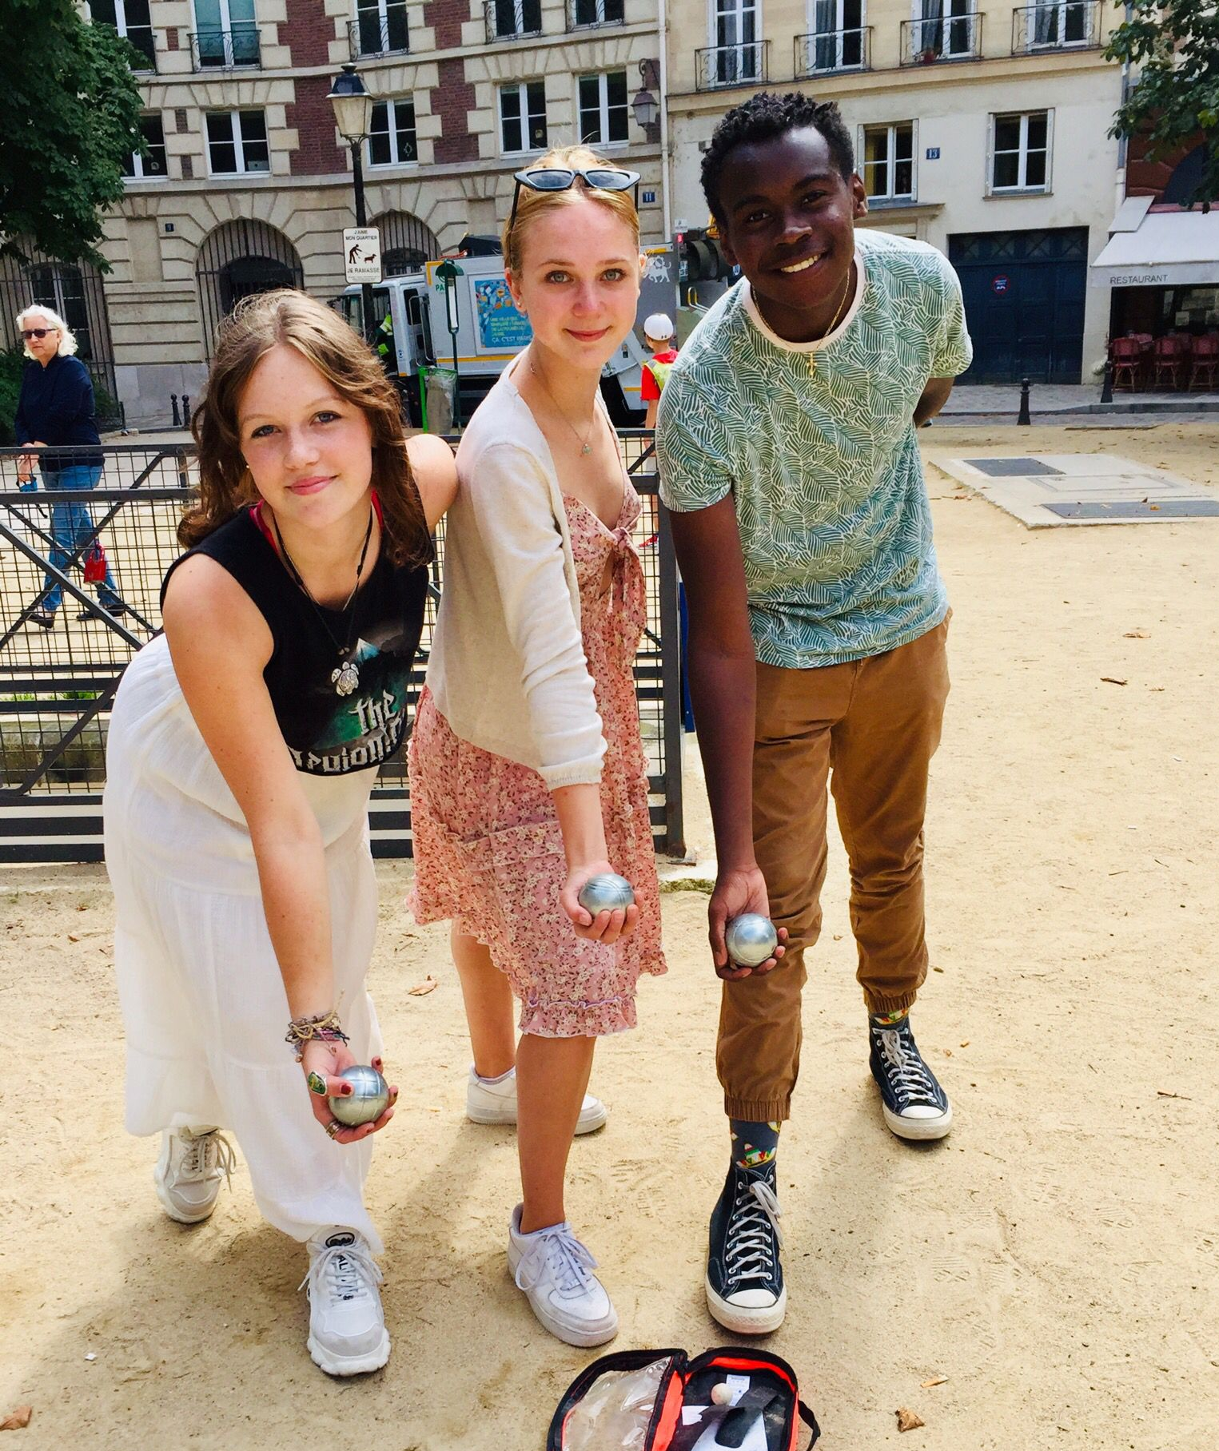
NEW VIEW OF MY OWN CULTURE & THE CULTURE OF MY HOST COUNTRY
What I thought of the US and my town before:
What changed about my view of the US:
What I thought of _______ before the program:
What changed about my view of ________:
[INSERT A PHOTO HERE THAT BEST ILLUSTRATES YOUR HOST COUNTRY’S CULTURE]

Slide 7
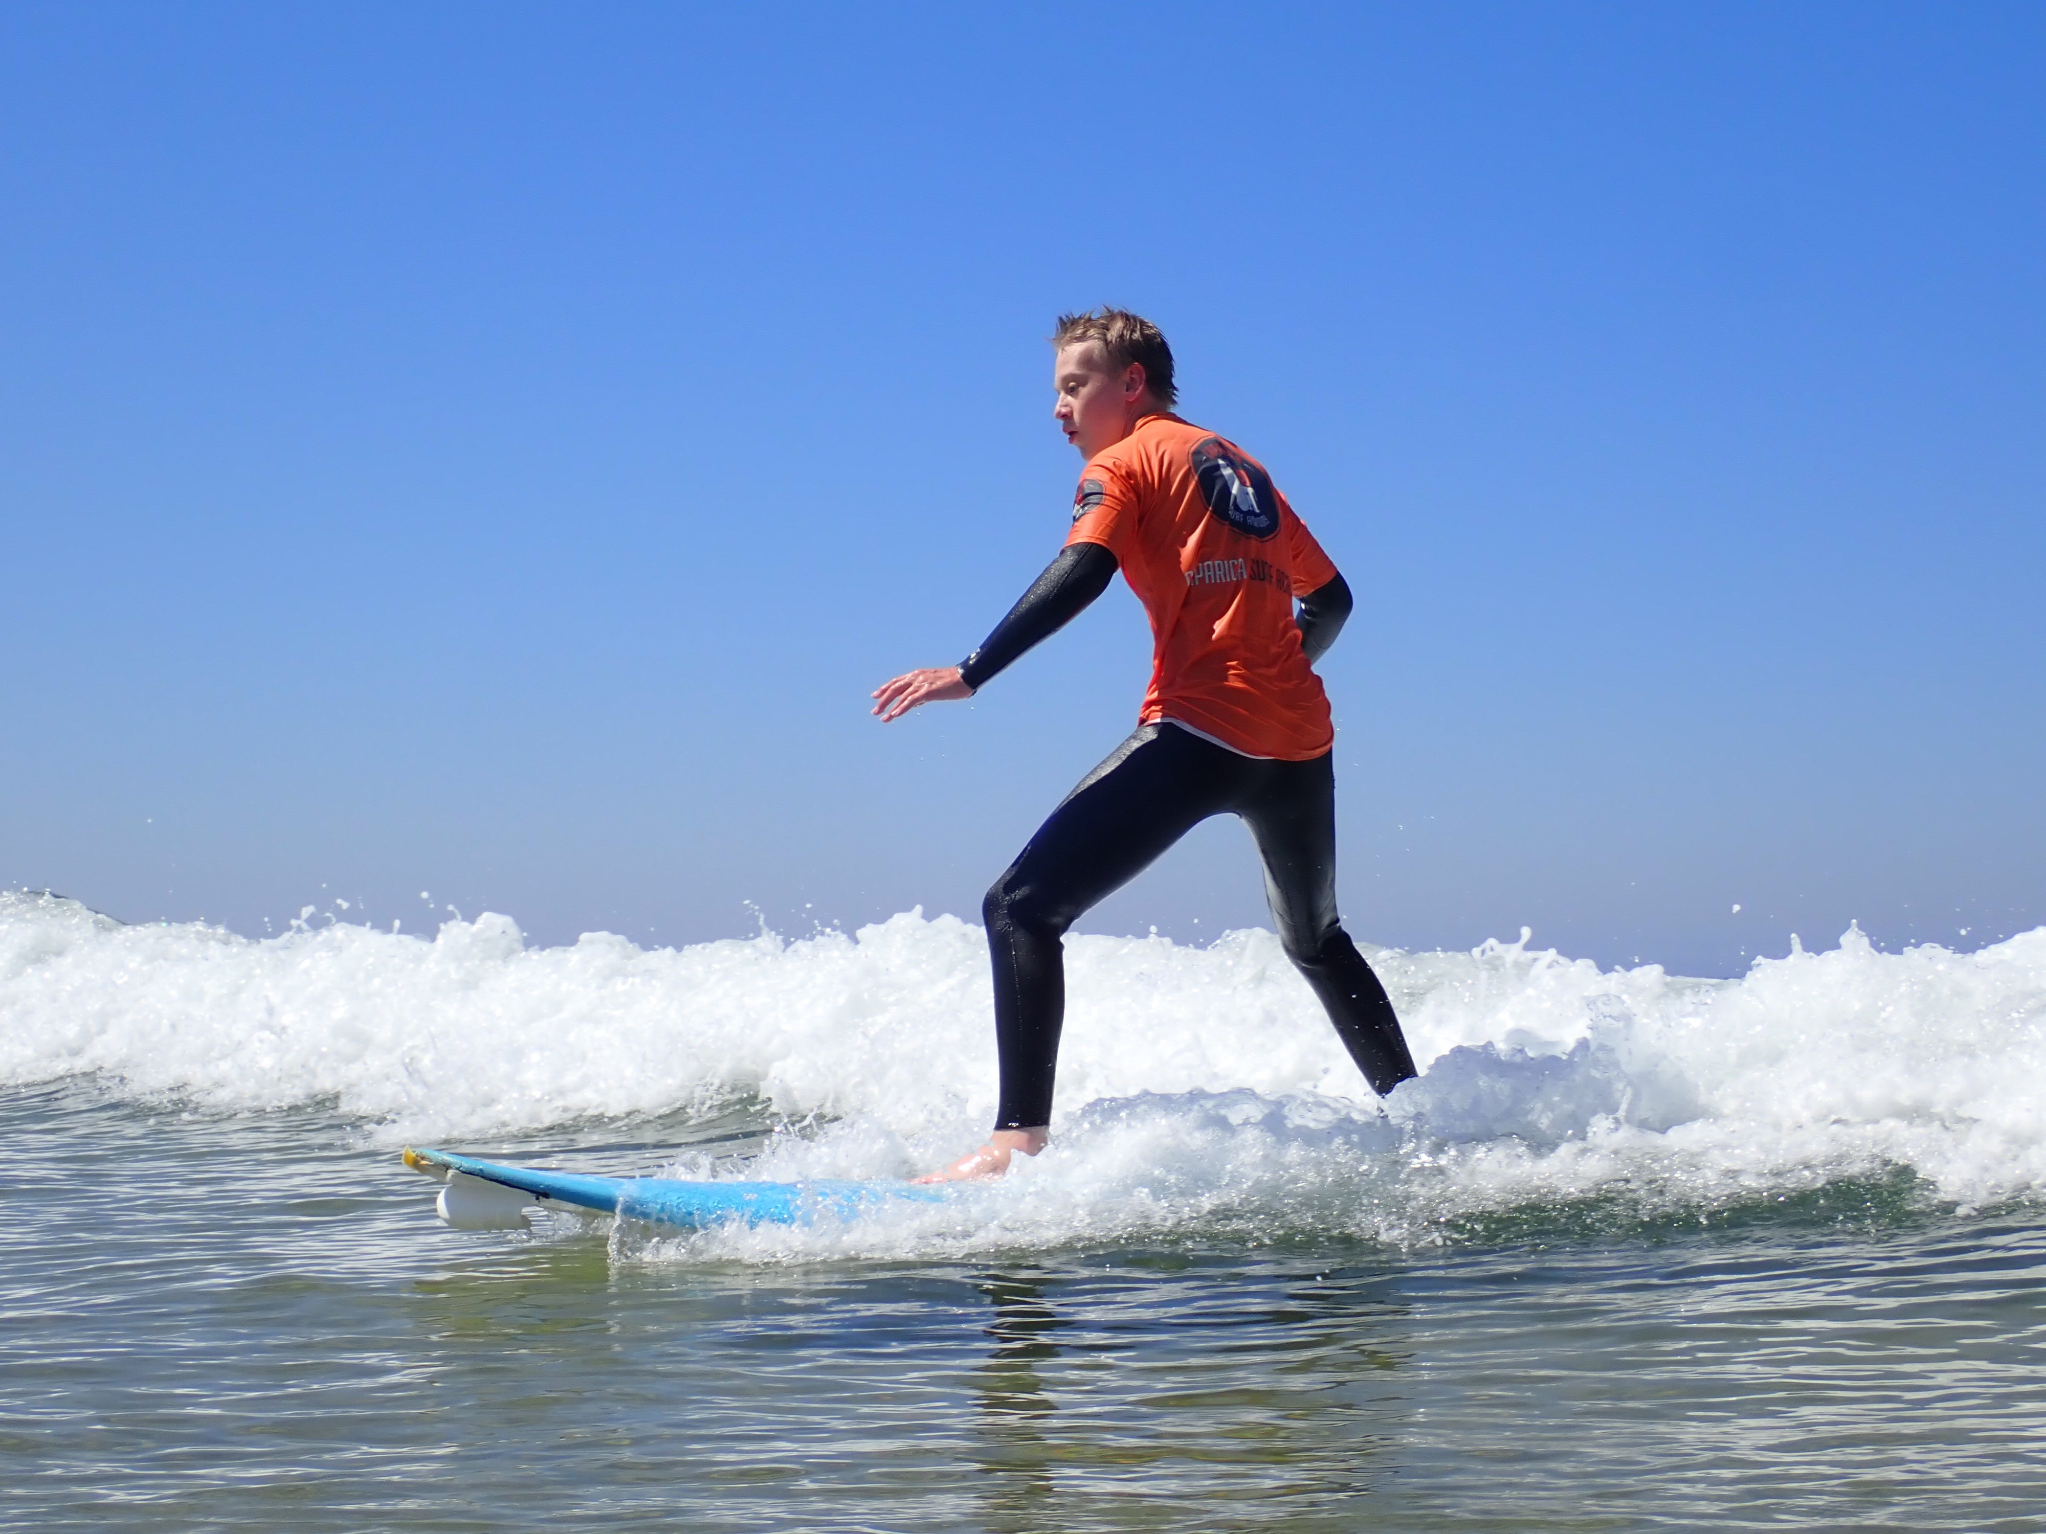
APPLYING FOR MY PROGRAM
How I heard about the program:
The online application was…
I knew (or did not know) other students at my school on my program:
The hardest part of the application was…
Study abroad is more affordable than you think (mention if you received a scholarship or were able to fundraise for your trip)
[INSERT A PHOTO HERE OF A FAVORITE MOMENT DURING YOUR STAY]

Slide 8
[SUM UP WHY YOU THINK STUDYING ABROAD IS IMPORTANT AND INVITE YOUR AUDIENCE TO CONSIDER PLACES THEY WOULD LIKE TO GO]

Slide 9
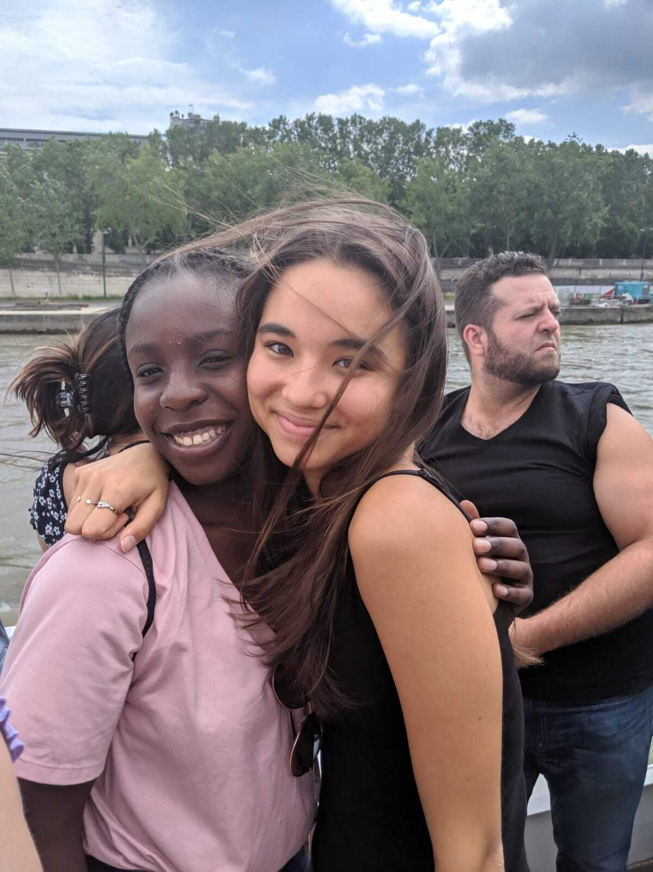
FUTURE PLANS
How this experience shaped me academically and personally
Post-high school plans and future study abroad plans
Service project plan for my own town [if applicable]
[INSERT A PHOTO HERE OF YOU AND YOUR BEST FRIEND ON PROGRAM]

Slide 10
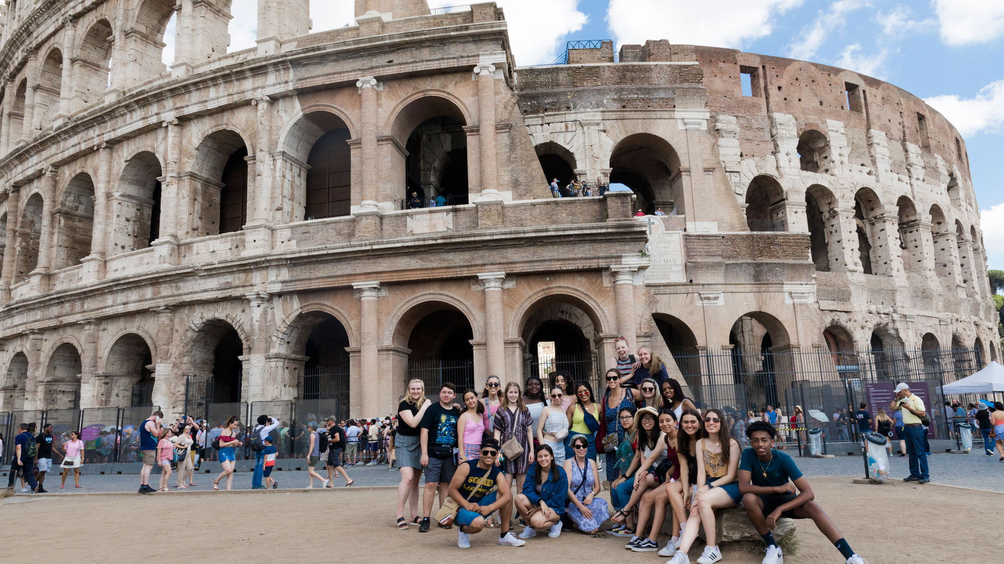
“
There is nothing like returning to a place that remains unchanged to find the ways in which you yourself have altered.”
—Nelson Mandela
ciee.org/hssa2022

